Slide 1
Introduction to Computer Science
(CSC 101)
Week 9
Practice

Slide 2
Microsoft Access 2016
Queries & Reports

Slide 3
Creating a database
Tables
Relationships
Forms

Slide 4
Database Queries
A database query is a request to access data from a database to manipulate it or retrieve it.
This allows us to perform logic with the information we get in response to the query.
Queries allow you to pull information from one or more tables based on a set of search conditions you define.

Slide 5
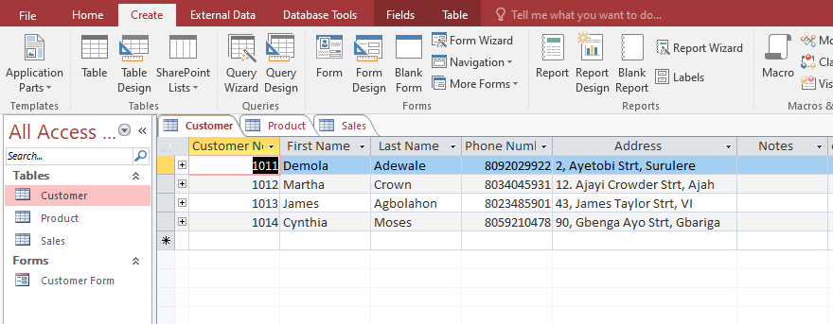
Create a query

Slide 6
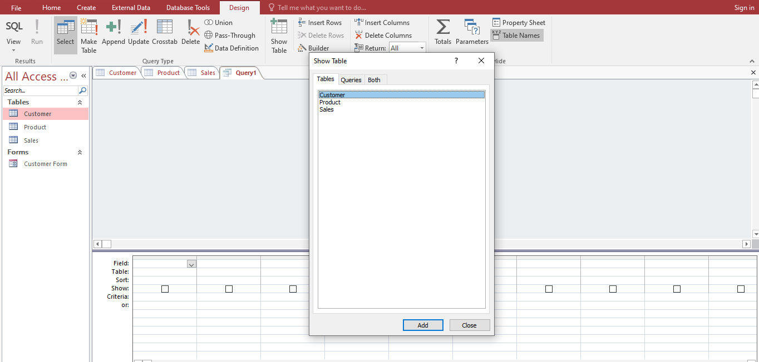
Create a query

Slide 7
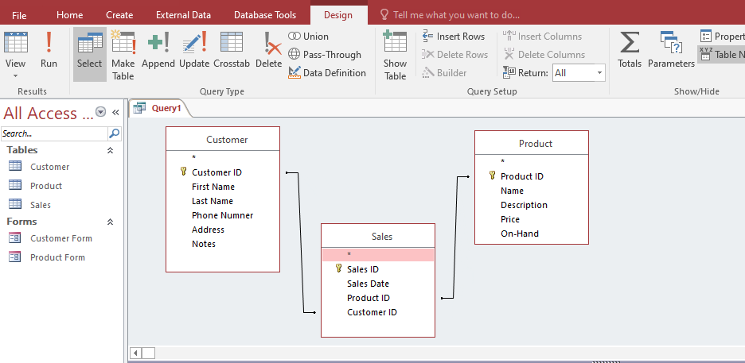
Create a query

Slide 8
Make a query
Query
Select customer first name, last name, product name, phone number, address and date of purchase.

Slide 9
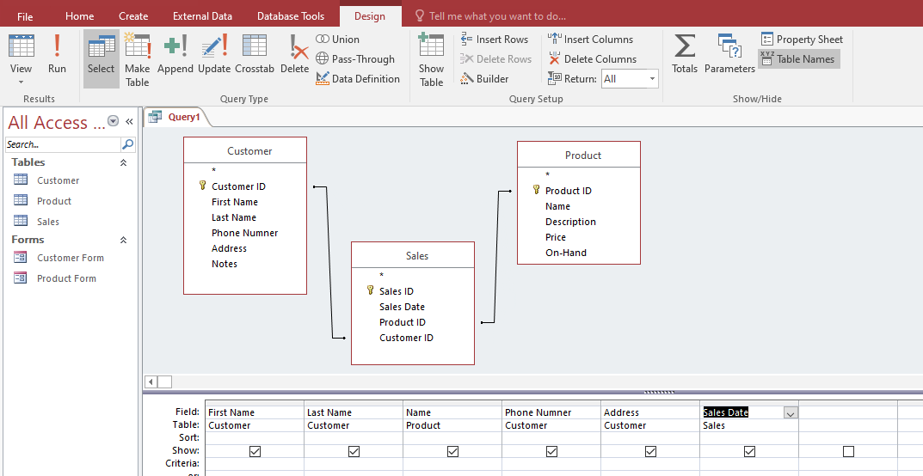
Make a query

Slide 10
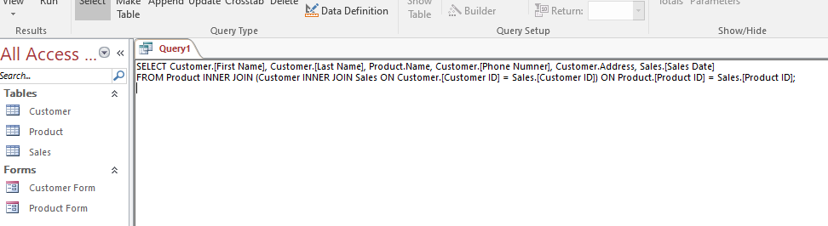
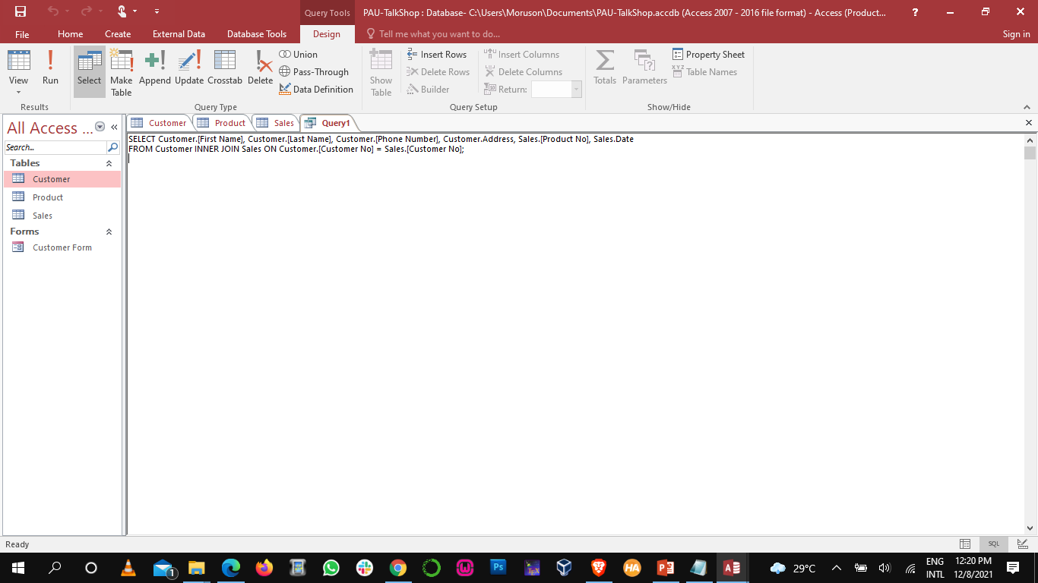
SQL Query

Slide 11
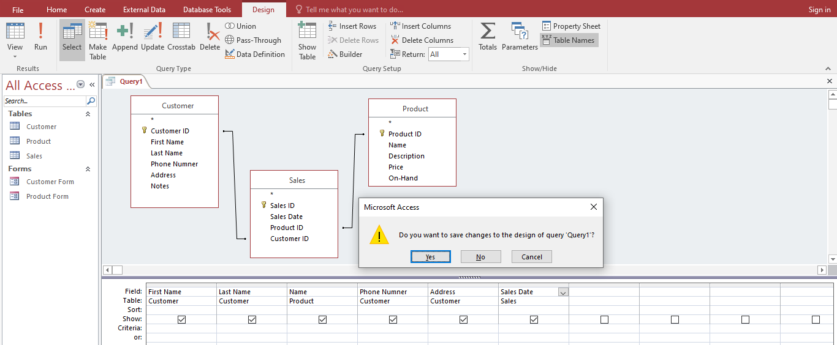
Make a query

Slide 12
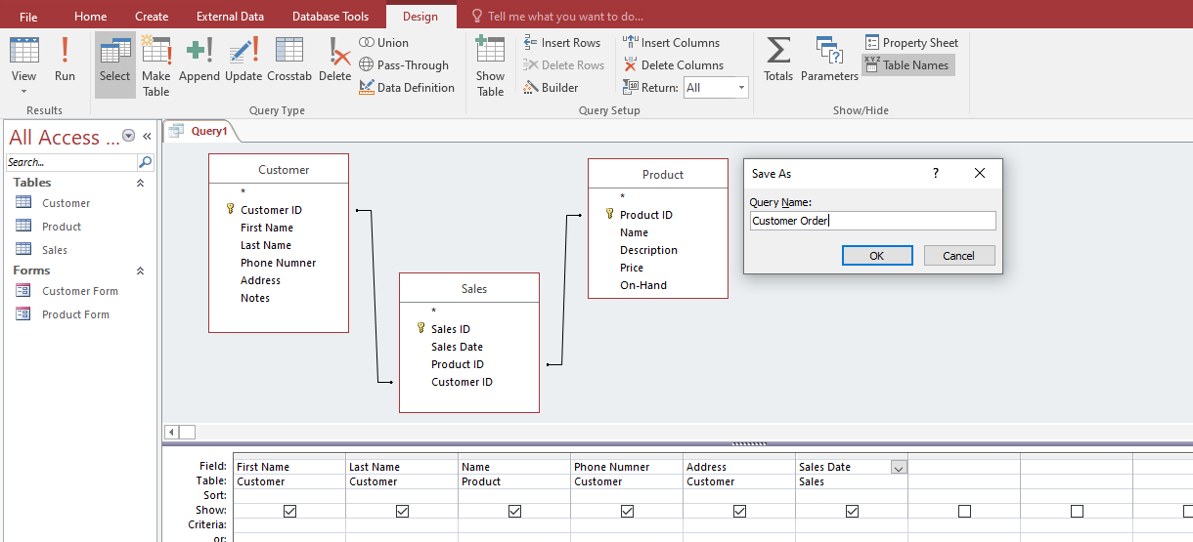
Make a query

Slide 13
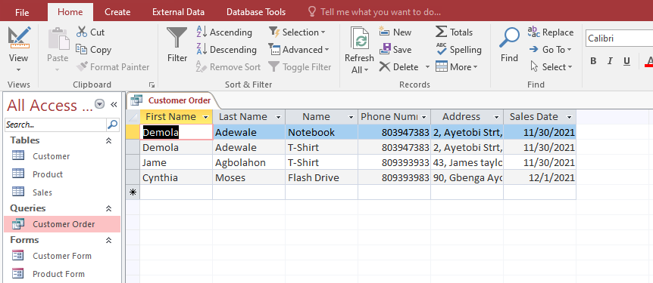
Make a query

Slide 14
Creating Reports
Reports allow you to organize and present your data in a reader-friendly, visually appealing format.
If you need to share information from your database with someone but don't want that person actually working with your database, consider creating a report.
Reports give you the ability to present components of your database in an easy-to-read, printable format.

Slide 15
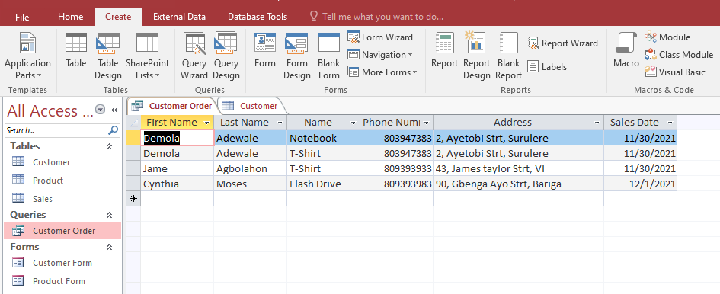
Creating Reports

Slide 16
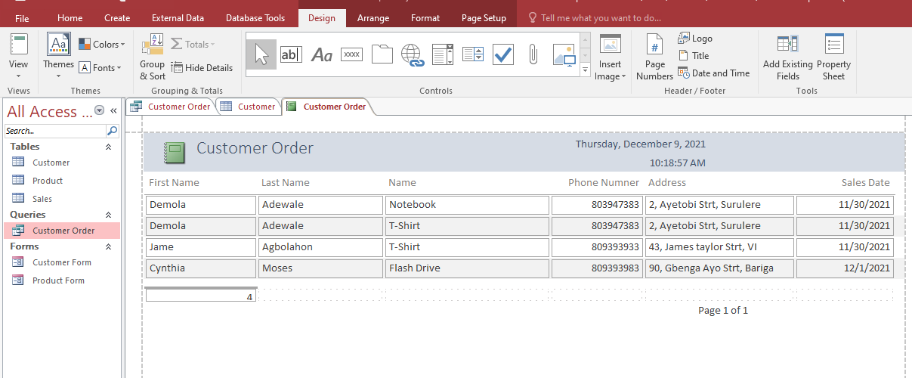
Creating Reports

Slide 17
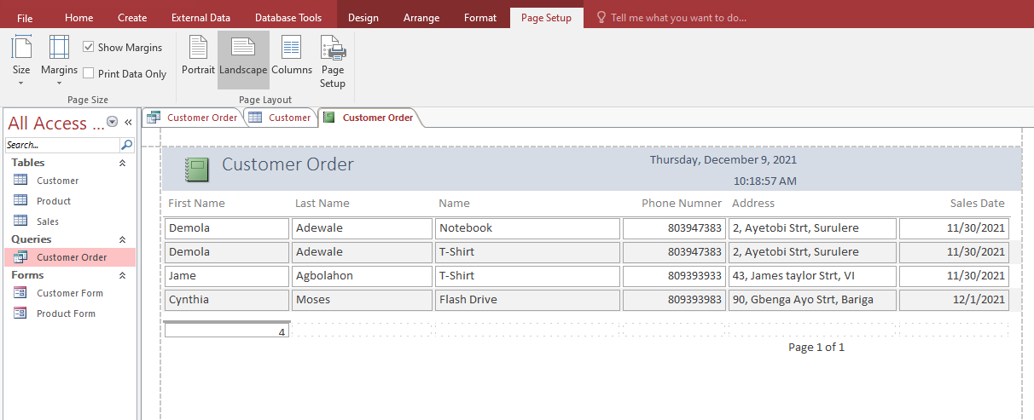
Creating Reports

Slide 18
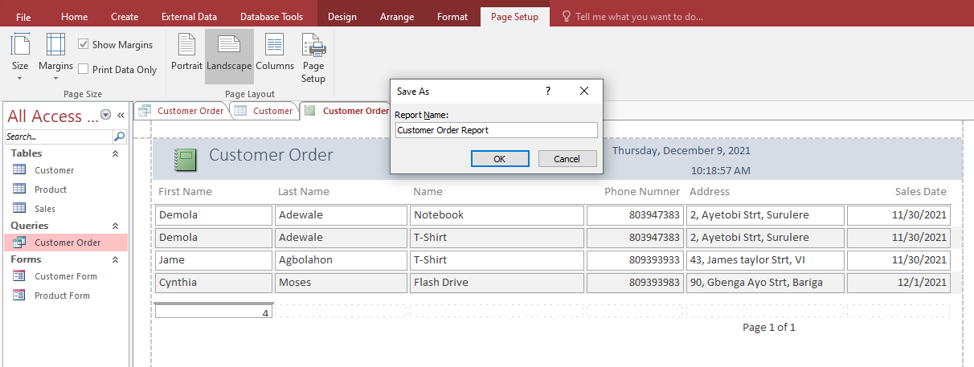
Creating Reports

Slide 19
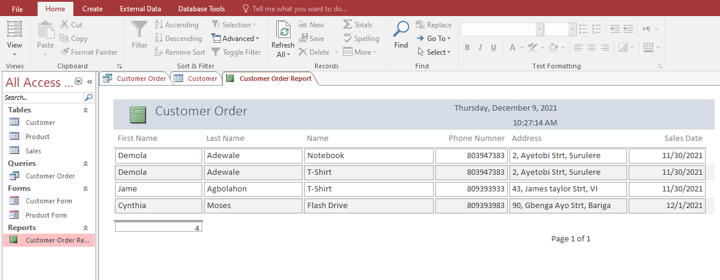
Creating Reports

Slide 20
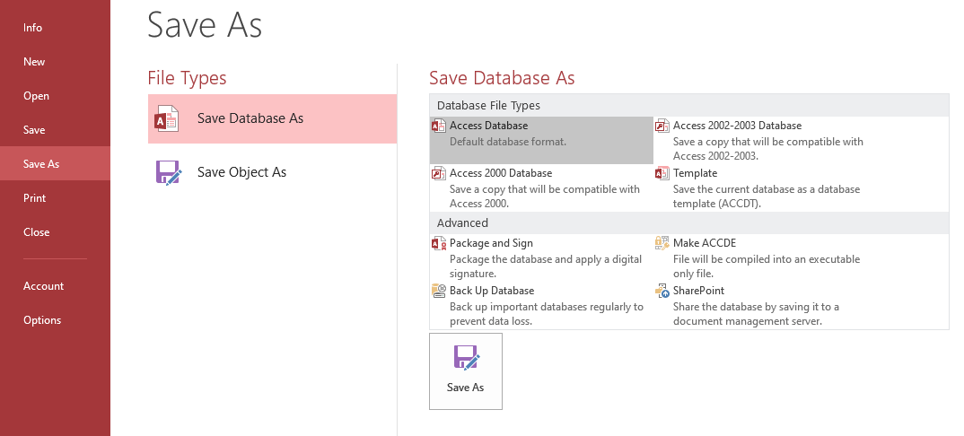
Save Database

Slide 21
Class Project I
1
Generate the Product Query Report
Create a Product Query from the TUC Shop database, for Product name, price, on-hand and sales date.
2

Slide 22
Class Project II
Generate the Student result Query Report
Create a Student Result Query from the developed database management system for SST, for student name, student level, course code and grade.

Slide 23
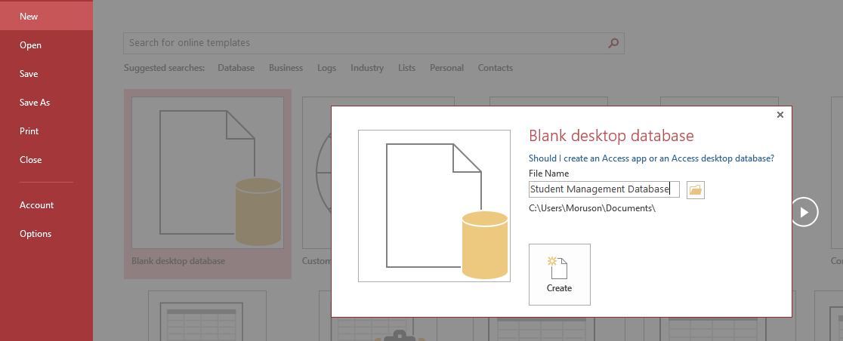
Inserting Table from Excel

Slide 24
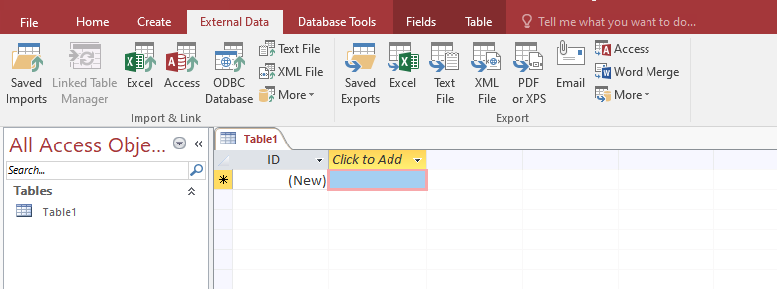
Inserting Table from Excel

Slide 25
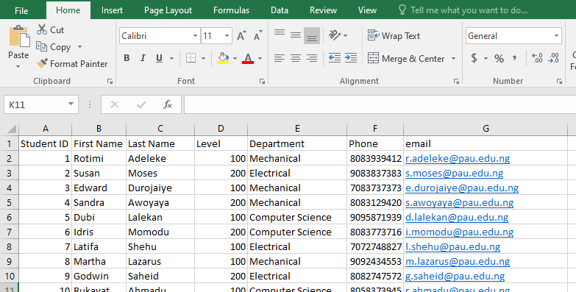
Inserting Table from Excel
Student_info.xlsx

Slide 26
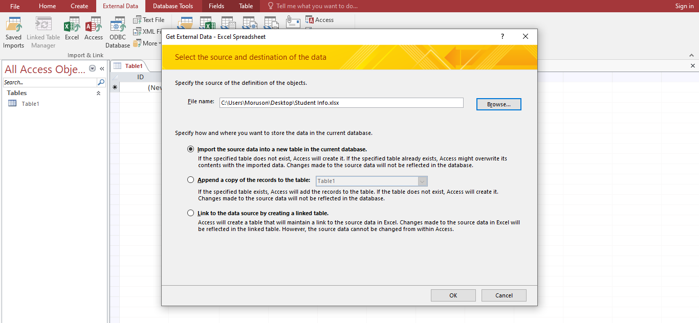
Inserting Table from Excel

Slide 27
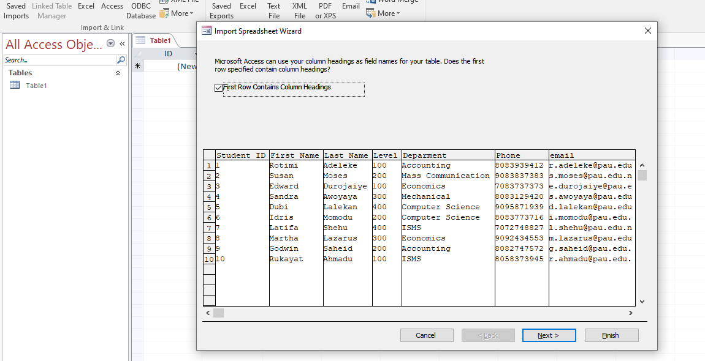
Inserting Table from Excel

Slide 28
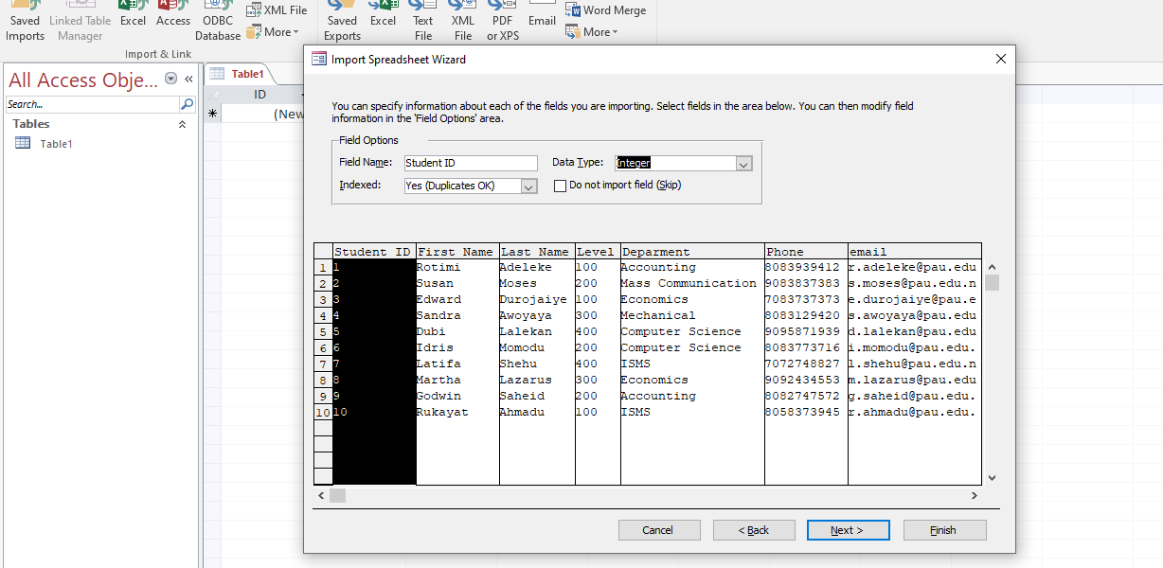
Inserting Table from Excel

Slide 29
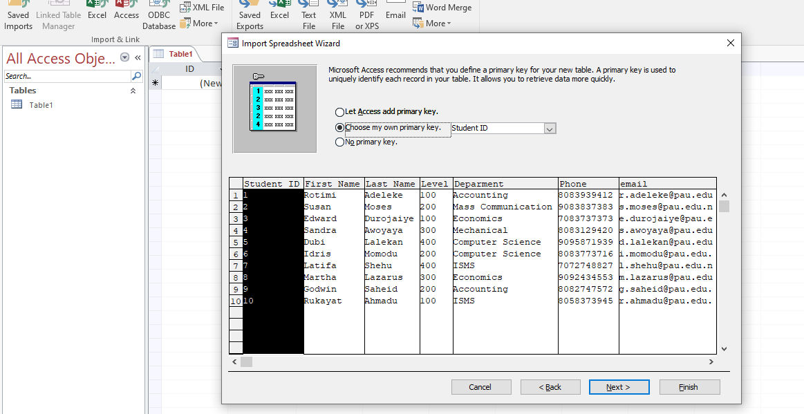
Inserting Table from Excel

Slide 30
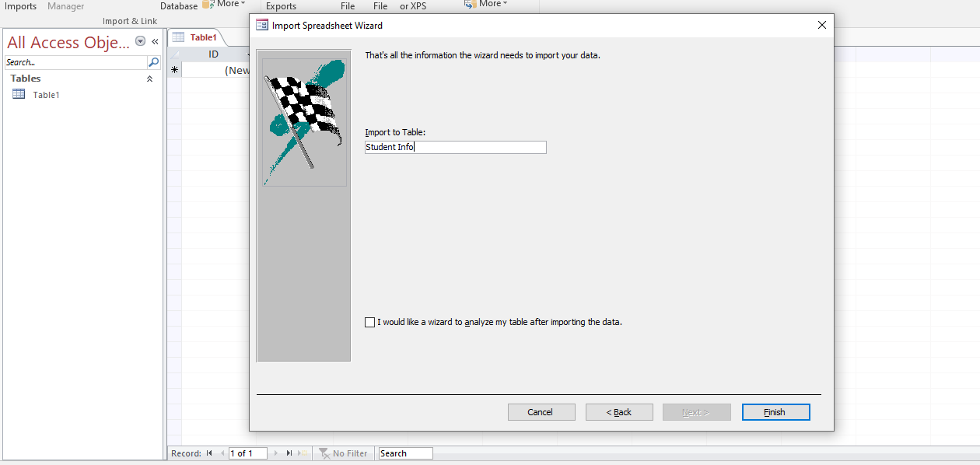
Inserting Table from Excel

Slide 31
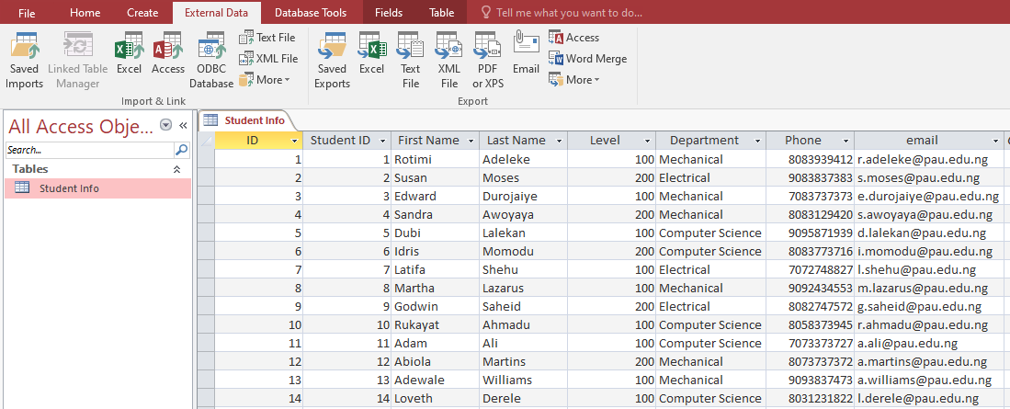
Inserting Table from Excel

Slide 32
Take Away!
Create a database Student Management System.
Create Student Info Query for Students in the following:
Insert the Student_Info.xlsx from the e-learning portal.
Generate the corresponding Reports from the 8 queries above.
CSC100 Level Query
CSC 200 Level Query
MEE 100 Level Query
MEE 200 Level Query
EEE 100 Level Query
EEE 200 Level Query
100 Level Students Query
200 Level Students Query

